Slide 1
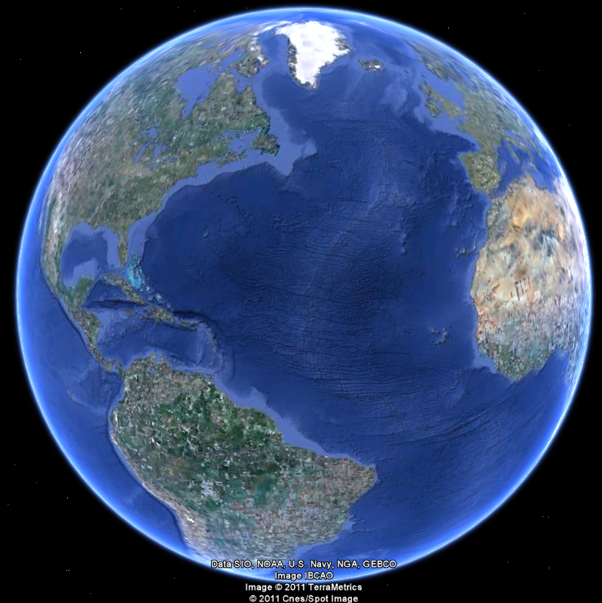
APEC 100 Sustainable Development
International Development and Poverty

Slide 2
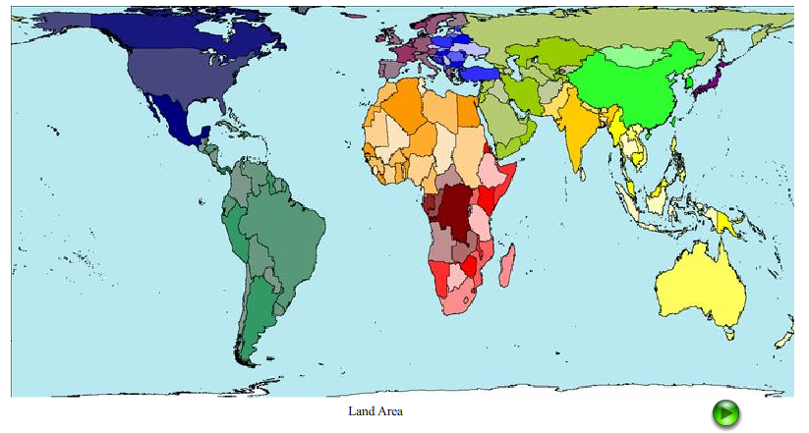
The World Sized by Land Area

Slide 3
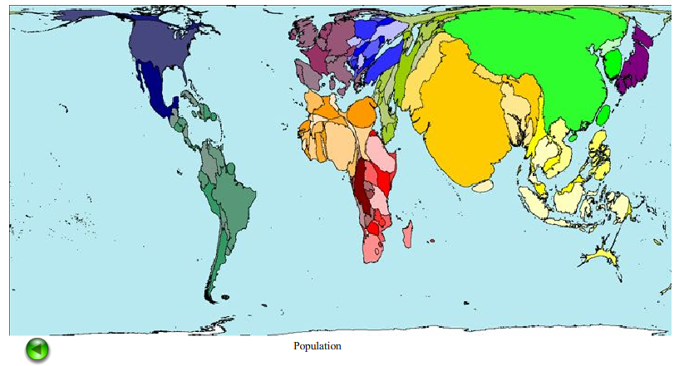
The World Sized by Population

Slide 4
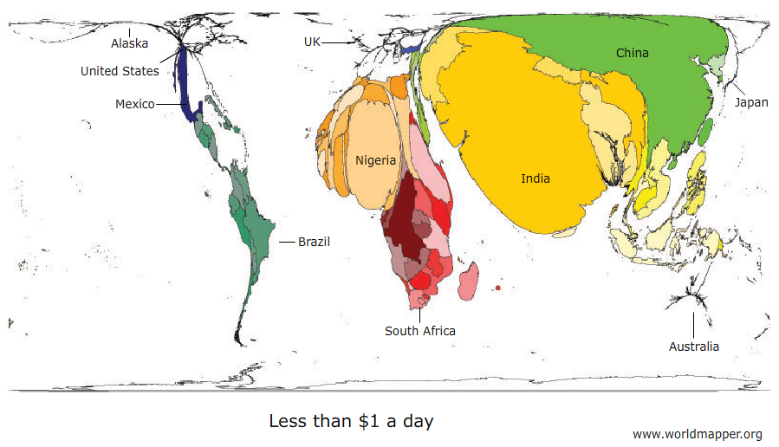
The World Sized by Income Less than $1 a day ($365/year)

Slide 5
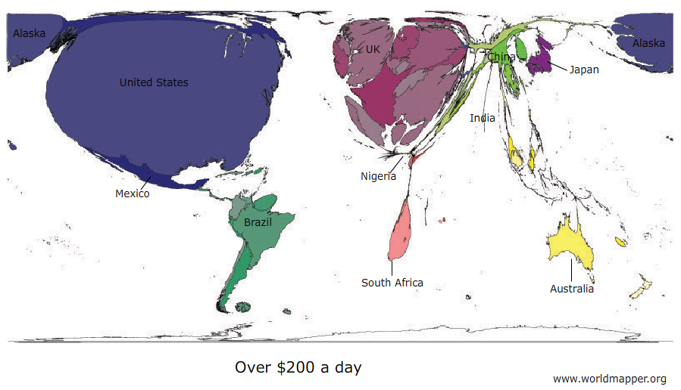
The World Sized by Income Over $200 a day ($73,000/year)

Slide 6
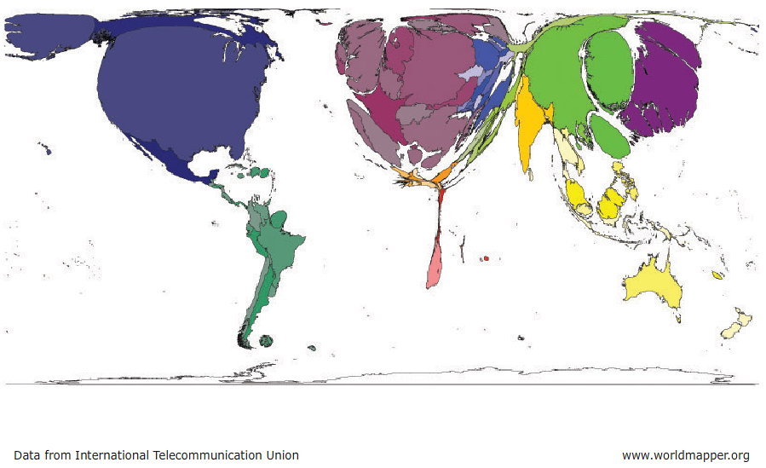
The World Sized by Internet Usage (Year 2000)

Slide 7
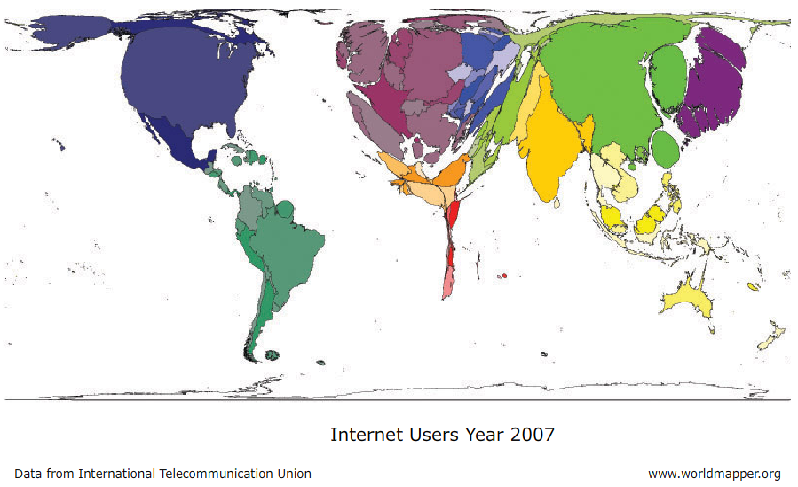
The World Sized by Internet Usage (Year 2007)

Slide 8
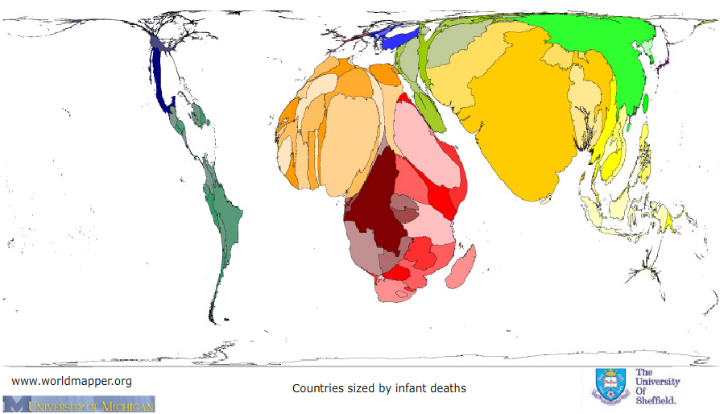
The World Sized by Infant Deaths

Slide 9
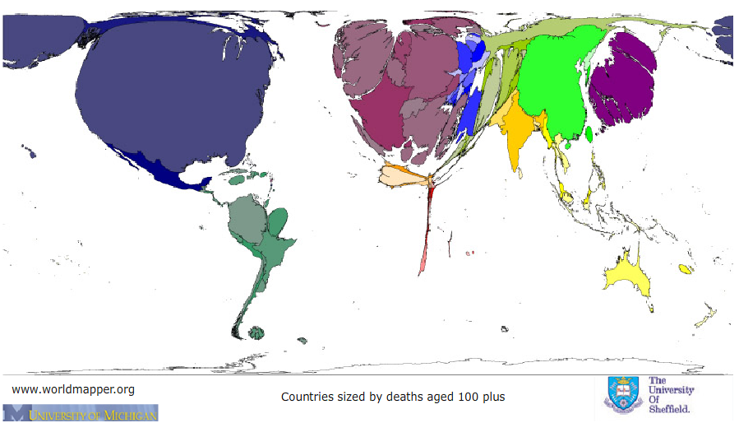
The World Sized by 100 years or older

Slide 10
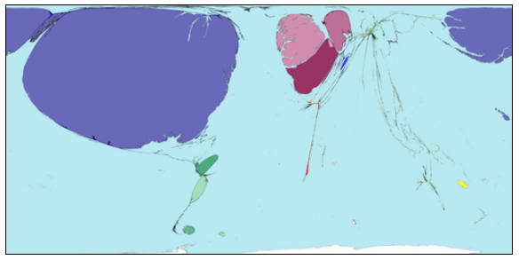
The World Sized by Royalties and License Fees Exports

Slide 11
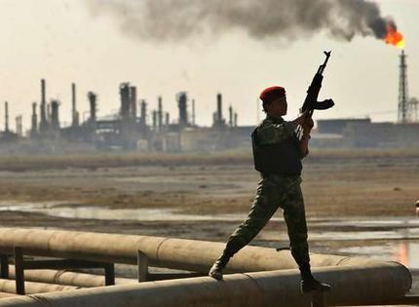
Exploitation of Natural Resources Necessary for Development?
Natural resources can provide an advantage in economic development.
However, in some cases, abundant natural resources of high value can be a detriment if it leads to internal wars over control.
Diamonds in the Congo
Oil in Nigeria, Libya
But not all developed countries relied on natural resources
Some used stocks of human entrepreneurial resources

Slide 12
Nine Factors to Improve Human Welfare
National unity (lack of internal conflict)
Market-oriented economy
Democratic form of government
Sound education system
Protection of private property rights
Opportunity for social and economic mobility
Level of economic growth exceeds the level of population growth
Corruption is relative minor.
Protection from the worse impacts of severe natural disasters

Slide 13
Why Market-Oriented Economy?
Adam Smith (Capitalism)
Production efficiency increases with labor specialization
Changes in the prices of goods signal producers to make more or to make less
Competition and profit incentives improve the availability and quality of goods
More efficient producers remain and the less efficient go out of business
Comparative advantage shows that trade will enable countries to specialize their production and will lead to increased wealth with both trading partners.
Karl Marx (Marxism)
Owners of land and machines oppress workers
Advocated a system where production and consumption follow abilities and needs
Toward a classless, stateless society with no private property
In general these systems failed because of inefficiency and the lack of incentives for individual hard work.
Ignored issues of comparative advantage

Slide 14
Why Property Rights?
Property rights protect a person’s access to a stream of benefits
Property rights promote investment
Text: Human creativity is closely associated with the extent that benefits return to the originator
Expropriation
Little evidence of success at improving human welfare.
Tragedy of the commons

Slide 15
The Roles of Government from a Capitalist Perspective
Collect revenue for public goods (could also provide these goods directly or hire others to do so)
Physical infrastructure, such as roads, airports, harbors, train stations
Public education (thought private markets can also provide)
Military defense
Provide institutional infrastructure
Enforcement of rights, regulation of food safety, health policy, etc
Perform as a market participant in cases of market failure
Sell electricity, provide insurance in case of moral hazard
Modify market outcomes with large externalities with policy instruments
Such as taxes on pollution.

Slide 16
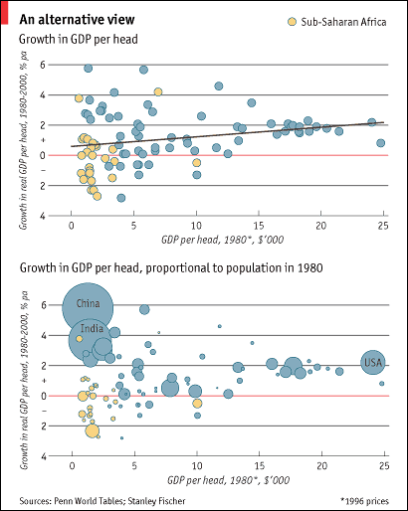
Source: “Catching up” The Economist Magazine, Aug 21st 2003

Slide 17
Source: “Catching up” The Economist Magazine, 2003

Slide 18
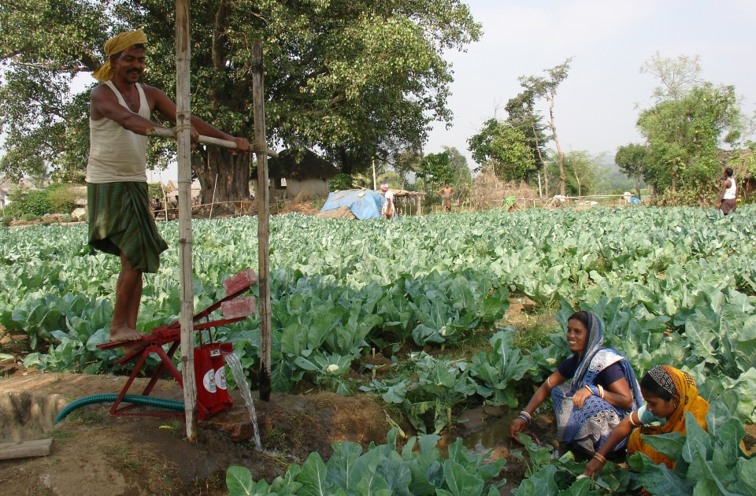
Case Study: International Development in India
Notes:
ICRISAT photo: India/Kothapally selected pictures

Slide 19
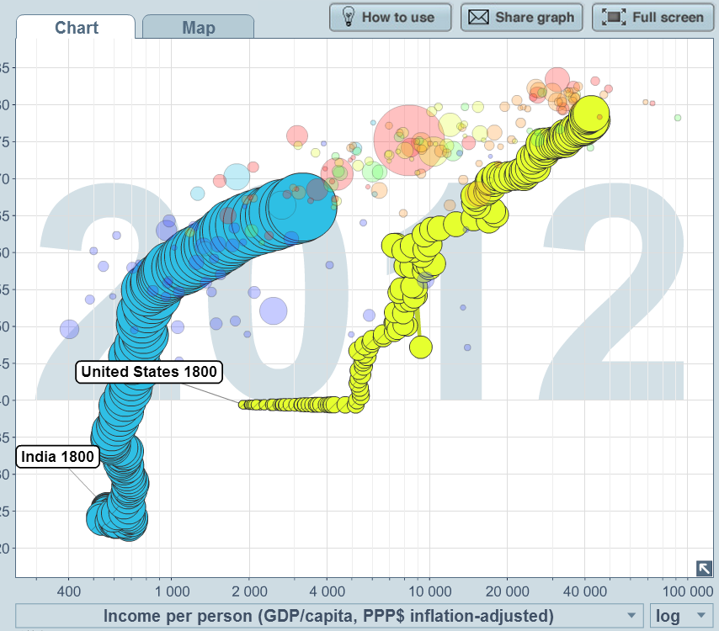
Wealth and Income over time
http://www.gapminder.org/

Slide 20
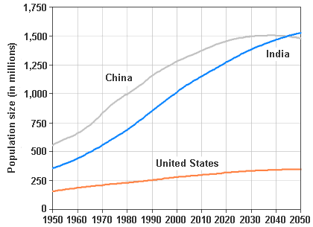
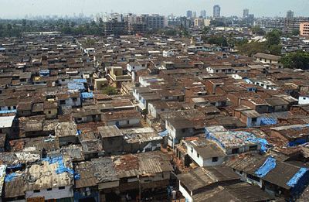
POPULATION
US: 319 million (2014)
India: 1,252 million (India contains ~18% of the world’s population)
India’s population is expected to surpass China’s by mid-century (India will then be the most populated country in the world)
Notes:
Information source: CIA Publications: World Factbook, India (https://www.cia.gov/library/publications/the-world-factbook/geos/IN.html) and the US (https://www.cia.gov/library/publications/the-world-factbook/geos/US.html), June 29, 2009
Content source: Adlakha, “International Brief: Population Trends: India,” US Department of Commerce: Economics and Statistics Administration Bureau of the Census. IB/97-1, April 1997. <http://www.census.gov/ipc/prod/ib-9701.pdf> June 30, 2009.
Photo source: Pratyush, “Maha Govt plant to demolish ‘Dharavi Slum’ to make high-rise mega blocks for slum-dwellers,” India Daily, Instablogs Network, May 31, 2007. <http://www.indiadaily.org/entry/maha-govt-plans-to-demolish-dharavi-slum-to-make-high-rise-mega-blocks-for-slum-dwellers/> June 30, 2009.
http://www.prb.org/Datafinder/Geography/Summary.aspx?region=142&region_type=2
http://geography.about.com/od/obtainpopulationdata/a/indiapopulation.htm
http://mw2.google.com/mw-panoramio/photos/medium/1526900.jpg

Slide 21
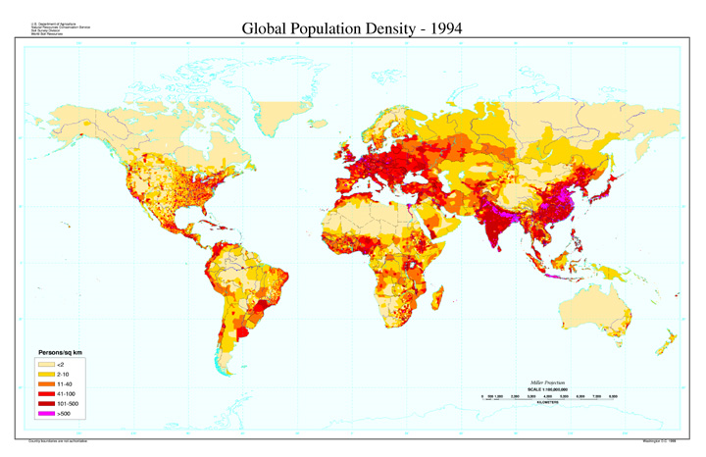
POPULATION DENSITY
US: 9,826,630 sq km
India: 3,287,590 sq km (about 1/3 the size of the US)
Content Source: CIA World Factbook, 2009
http://soils.usda.gov/use/worldsoils/mapindex/popden.html
Notes:
Information source: CIA Publications: World Factbook, India (https://www.cia.gov/library/publications/the-world-factbook/geos/IN.html) and the US (https://www.cia.gov/library/publications/the-world-factbook/geos/US.html), June 29, 2009
Picture source: CIA Publications, World Factbook, Regional Maps: Political World (https://www.cia.gov/library/publications/the-world-factbook/maps/refmap_political_world.html), June 29, 2009
http://travel.nationalgeographic.com/places://www.mapsofindia.com/india-climate.html
Photo source: US Department of Agriculture Natural Resources Conservation Service, Global Population Density Map <http://soils.usda.gov/use/worldsoils/mapindex/popden.html> June 30, 2009.

Slide 22
POPULATION DENSITY
US: 9,826,630 sq km
India: 3,287,590 sq km (about 1/3 the size of the US)
Content Source: CIA World Factbook, 2009
http://soils.usda.gov/use/worldsoils/mapindex/popden.html
Notes:
Information source: CIA Publications: World Factbook, India (https://www.cia.gov/library/publications/the-world-factbook/geos/IN.html) and the US (https://www.cia.gov/library/publications/the-world-factbook/geos/US.html), June 29, 2009
Picture source: CIA Publications, World Factbook, Regional Maps: Political World (https://www.cia.gov/library/publications/the-world-factbook/maps/refmap_political_world.html), June 29, 2009
http://travel.nationalgeographic.com/places://www.mapsofindia.com/india-climate.html
Photo source: US Department of Agriculture Natural Resources Conservation Service, Global Population Density Map <http://soils.usda.gov/use/worldsoils/mapindex/popden.html> June 30, 2009.

Slide 23
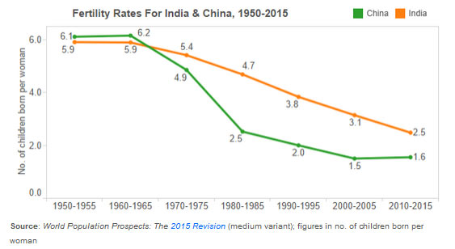
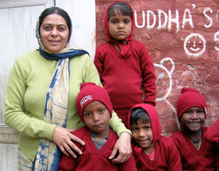
INDIA’S POPULATION: FERTILITY RATES
Why does India’s population continue to grow?
Population has more than tripled since 1974
In the 1950’s, the total fertility rate was 5.9 children/woman
The 2016 fertility rate is 2.3 children/woman
Notes:
Content source: CIA Publications: World Factbook, India (https://www.cia.gov/library/publications/the-world-factbook/geos/IN.html) and the US (https://www.cia.gov/library/publications/the-world-factbook/geos/US.html), June 30, 2009
Content source: Adlakha, “International Brief: Population Trends: India,” US Department of Commerce: Economics and Statistics Administration Bureau of the Census. IB/97-1, April 1997. <http://www.census.gov/ipc/prod/ib-9701.pdf> June 30, 2009.
Photo source: Hayatgheyb, Heidi K. Brenner. “India’s Children Beggars Go to School,” Amistad International, 2009. <http://www.amistadinternational.org/pages/indias_beggars.html> June 30, 2009.

Slide 24
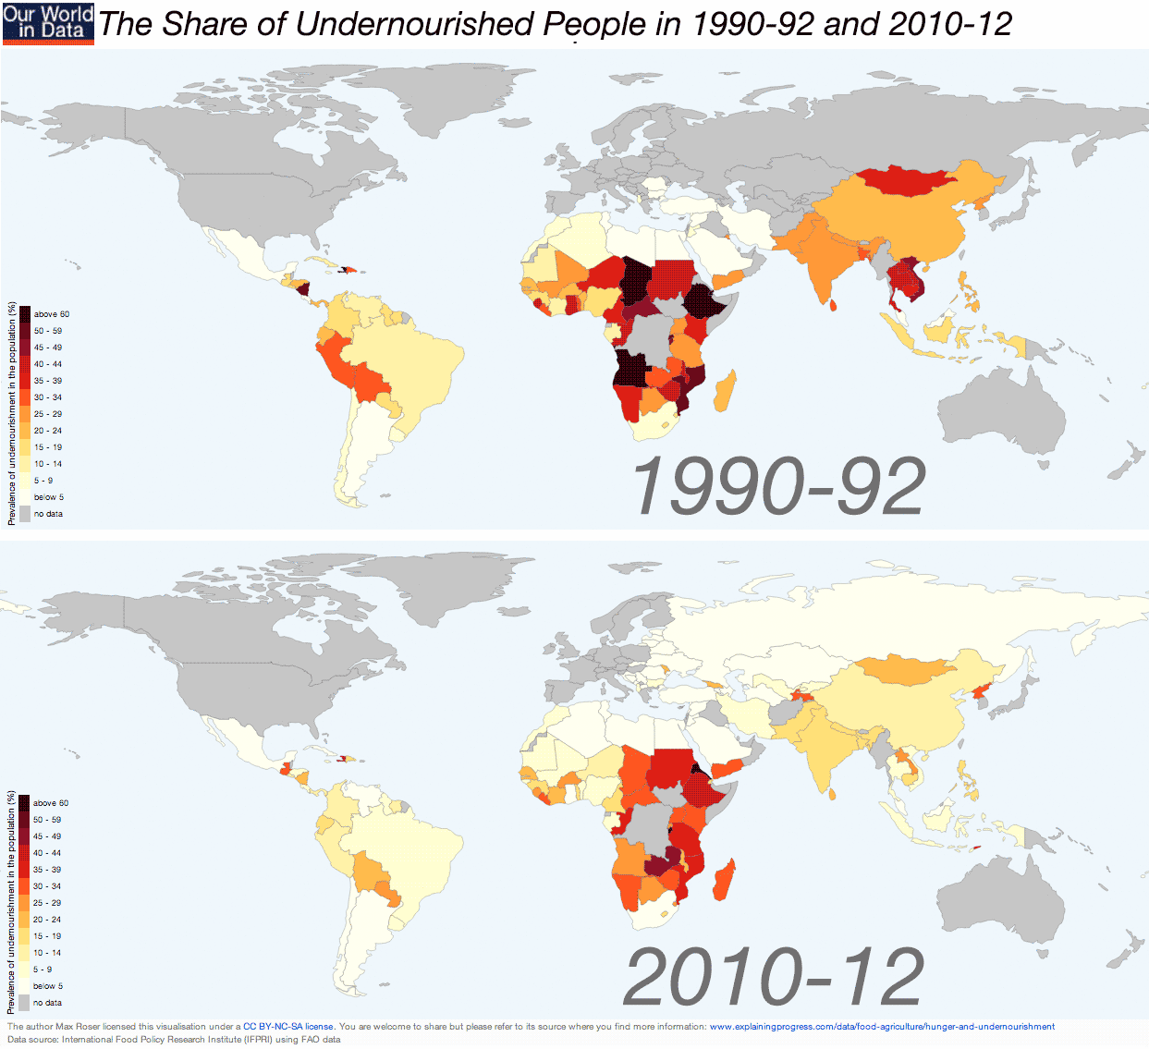
Malnourishment is a serious problem in India
Notes:
Content source: Caplin, Jessica. “Feeding an Elephant: Malnutrition and the Right to Food in India,” Harvard International Review. Fall 2008.

Slide 25
Malnourishment is Getting Better
Notes:
Content source: Caplin, Jessica. “Feeding an Elephant: Malnutrition and the Right to Food in India,” Harvard International Review. Fall 2008.

Slide 26
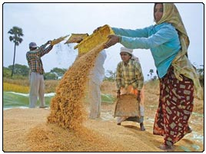
Food Quantity & Supply
60% of whom live in rural areas with little access to infrastructure, modern technology, and adequate health services
However, over the last 30 years (thanks to the Green Revolution) India has seen a 106% increase in domestic food production
India has long experienced a surplus in grain, enough to satisfy the demands of the 46 million children serviced by the Public Distribution Service (~4.8% of India’s population)
Notes:
Content source: Caplin, Jessica. “Feeding an Elephant: Malnutrition and the Right to Food in India,” Harvard International Review. Fall 2008.
Photo source: Seelam, Noah, “India’s Economy: The Boom from the Bottom,” ISKCON News Weekly, Feb. 14, 2009 <http://news.iskcon.com/node/1857/2009-03-28/indias_economy_boom_bottom> July 29, 2009.

